Slide 1
SOFTWARE DEVELOPMENT PROJECT MANAGEMENT (CSC4125)
Lecture 7: Activity Planning

Slide 2
Activity Planning
To ensure that the appropriate resources will be available precisely when required
To avoid different activities competing for the same resources at the same time
To produce a detailed schedule showing which staff carry out each activity
To produce a detailed plan against which actual achievement may be measured
To produce a timed cash flow forecast
To replan the project during its life to correct drift from the target

Slide 3
The Objectives of Activity Planning
In addition to providing project and resource schedules, activity planning aims to achieve a number of other objectives –
Feasibility Assessment
Resource Allocation
Detailed Costing
Motivation
Co-ordination

Slide 4
Project Schedules
Creating a Project Schedule comprises four main stages –
Ideal Activity Plan – What activities need to be carried out, what is the estimated duration of each activity and in what order they are to be done
Activity Risk Analysis – Identifying potential problems and suggesting alterations to the ideal activity plan
Resource Allocation – Identifying expected resource availability and constraints and adapting ideal plan accordingly
Schedule Production – Drawing up and publishing a project schedule, which indicates planned start and completion dates and resource requirements for each activity

Slide 5
Projects and Activities
Defining Activities
A project is composed of a number of inter-related activities
A project may start when at least one of its activities is ready to start
A project will be completed when all of the activities it encompasses have been completed
An activity must have a clearly defined start and a clearly defined end-point, normally marked by the production of a tangible deliverable
If an activity requires a resource (as most do) then that resource requirement must be forecastable and is assumed to be required at a constant level throughout the duration of the activity
The duration of an activity must be forecastable – assuming normal circumstances and the reasonable availability of resources
Some activities may require that others are completed before they can begin (these are known as precedence requirements)

Slide 6
Projects and Activities
Identifying Activities –There are Three approaches to identify the activities /tasks that make up a project –
Activity-based approach
Creating a list of all the activities that the project is thought to involve, or
Draw-up a Work Breakdown Structure (WBS) listing the work items needed (This involves identifying the main/high-level tasks required to complete a project and then breaking each of these down into a set of lower-level tasks)
Product-based approach
List the deliverables and intermediate products of project – Product Breakdown Structure (PBS)
Identify the order in which products have to be created
Work out the activities needed to create the products
Hybrid approach
WBS based on Deliverables and Activities

Slide 7
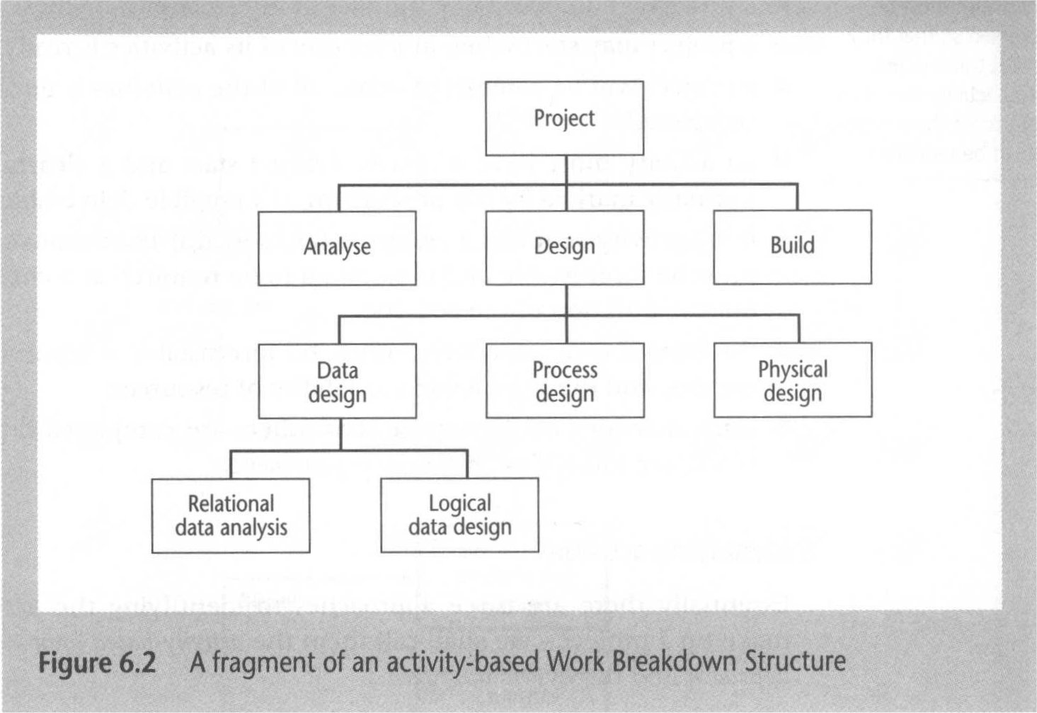
A fragment of an Activity-Based WBS

Slide 8
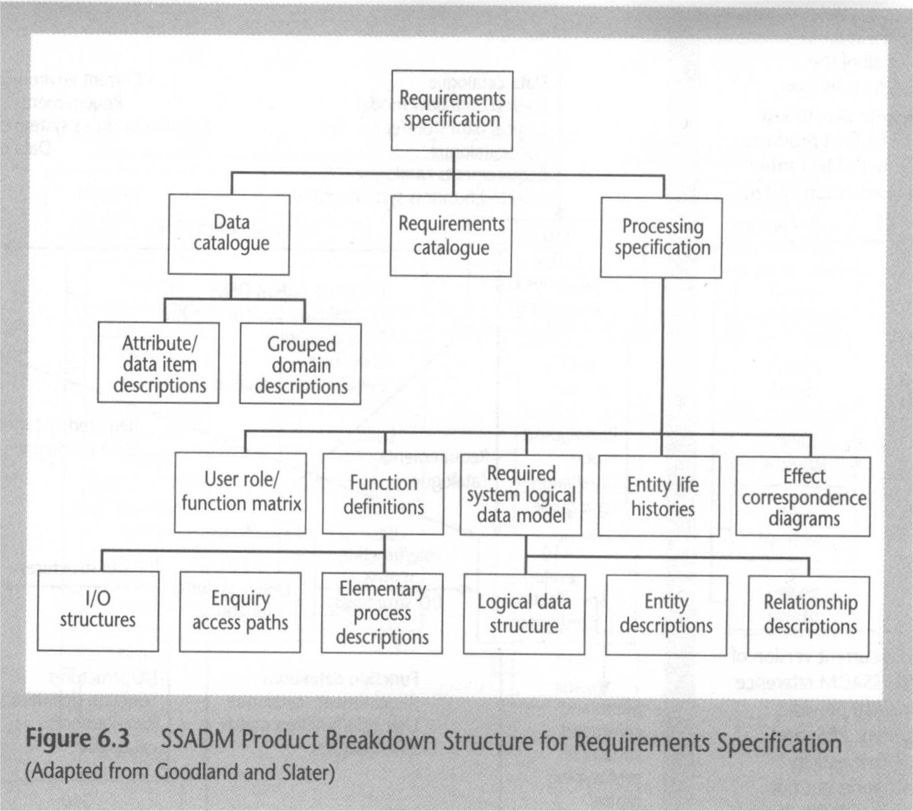
Product-Based WBS

Slide 9
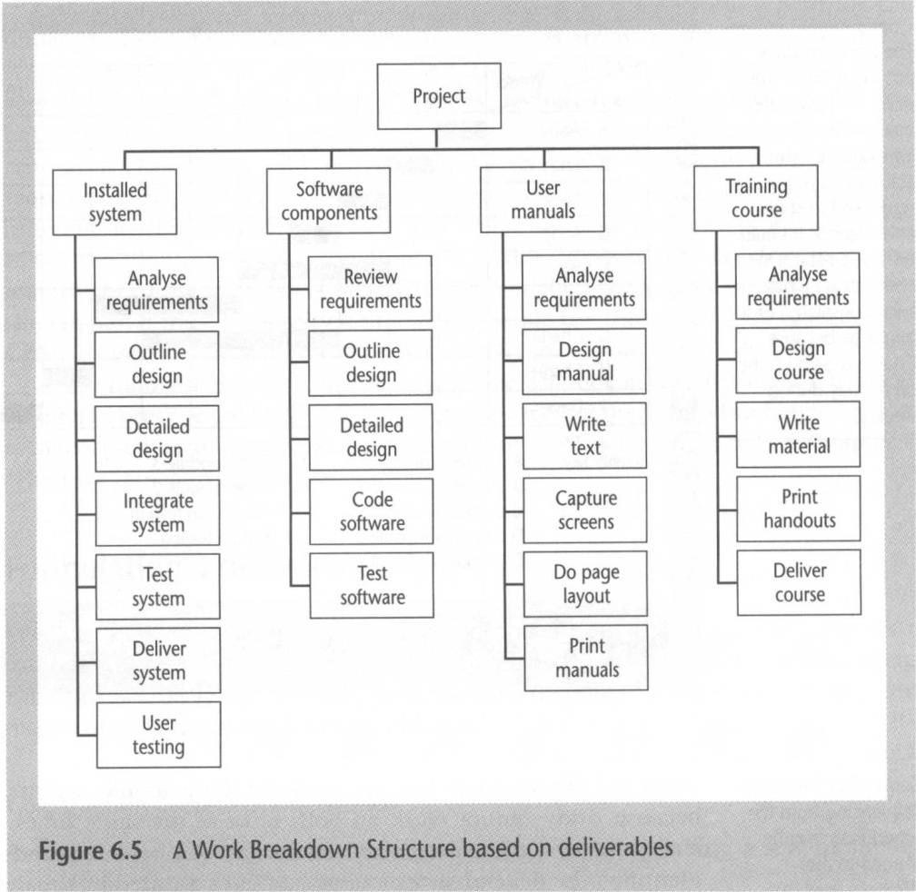
Hybrid WBS based on deliverables and activities

Slide 10
Sequencing and Scheduling Activities
Throughout a project, we require a schedule that clearly indicates when each of the project’s activities is planned to occur and what resources it will need.
One way of represent a project plan is to use a bar chart.
When drawing a bar chart, we do two things –
Sequence the tasks
Schedule the tasks

Slide 11
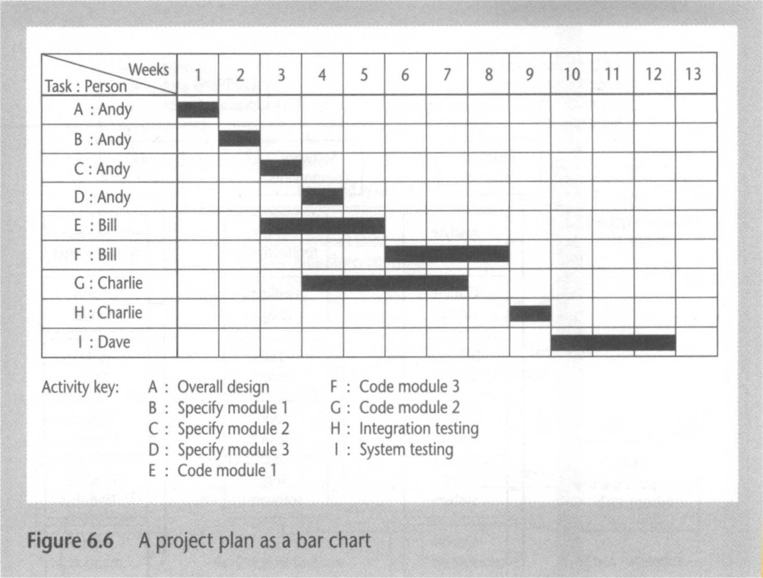
A project plan as a Bar Chart
The chart tells us who is doing what and when

Slide 12
Network Planning Models
CPM – Critical Path Method
PERT – Program Evaluation Review Technique
Both CPM & PERT methods originally used Activity-On-Arrow
Precedence Networks ==> Activity-On-Node

Slide 13
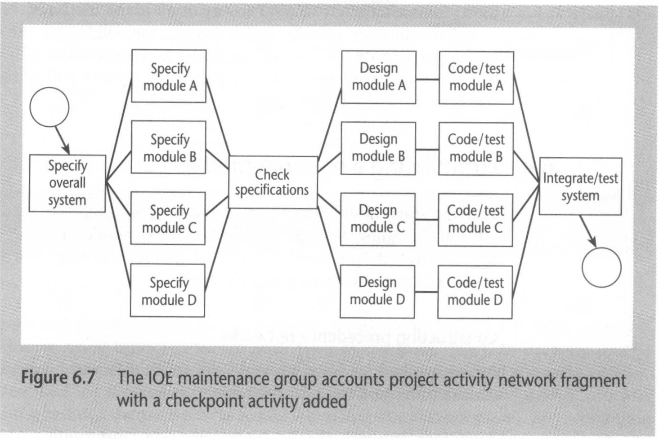
IOE Activity Network Fragment
Example: Activity on Node

Slide 14
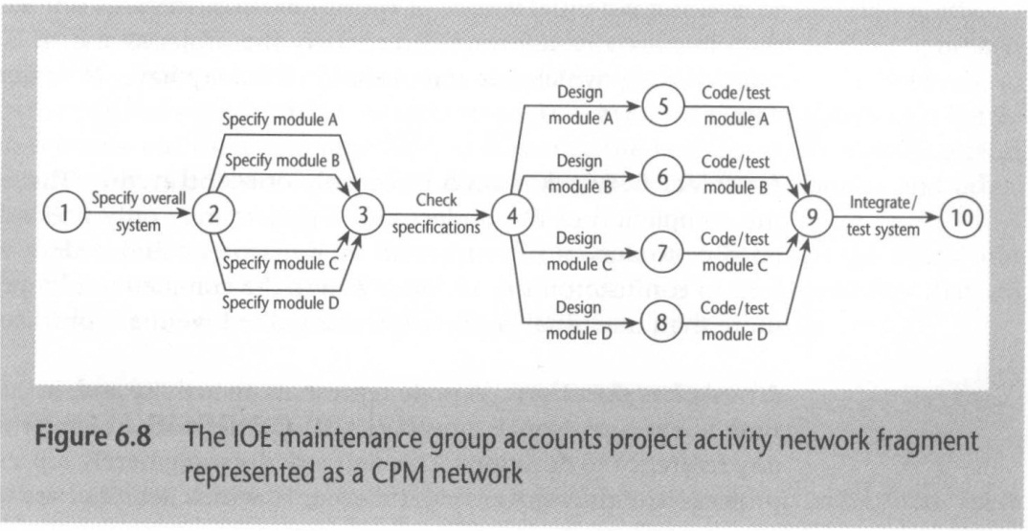
IOE Activity CPM Network Fragment
Example: Activity on Arrow

Slide 15
Formulating a Network Model
Constructing Precedence Networks
A project network should have only one start node
A project network should have only one end node
A node has duration
Links normally have no duration
Precedents are the immediate preceding activities
Time moves from left to right
A project network should not contain loops
A project network should not contain dangles
Representing lagged activities – Lagged Activities are shown on the arrows with a duration
Hammock activities –Have Zero duration. Represents Resources such as Overheads with Constant Cost Over the Duration of a Set of Activities
Labeling Conventions

Slide 16
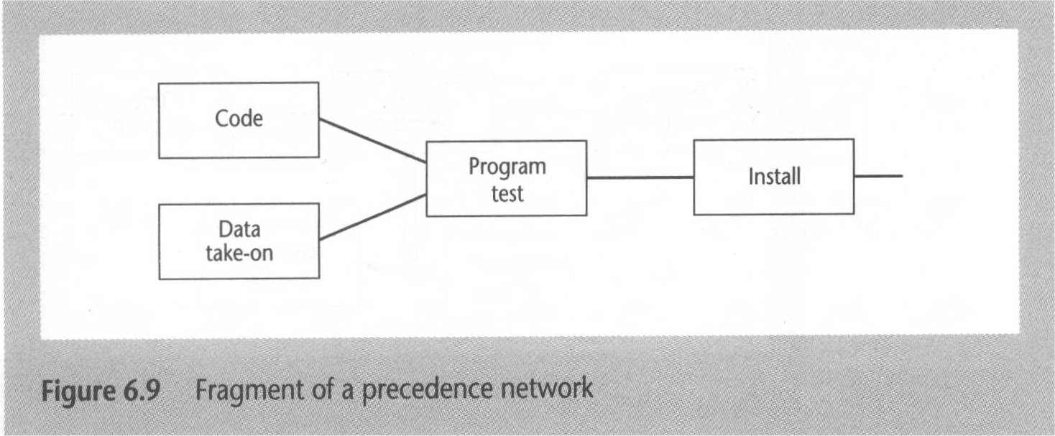
Fragment of a Precedence Network

Slide 17
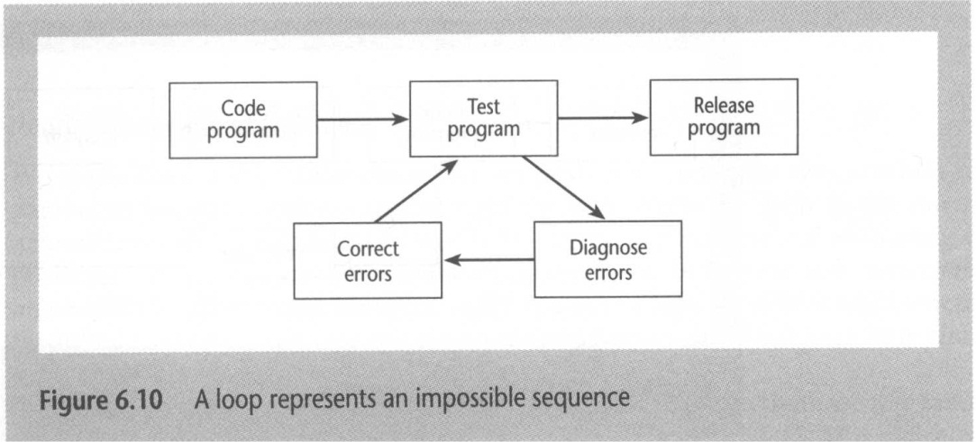
Loops are NOT allowed in Precedence Network

Slide 18
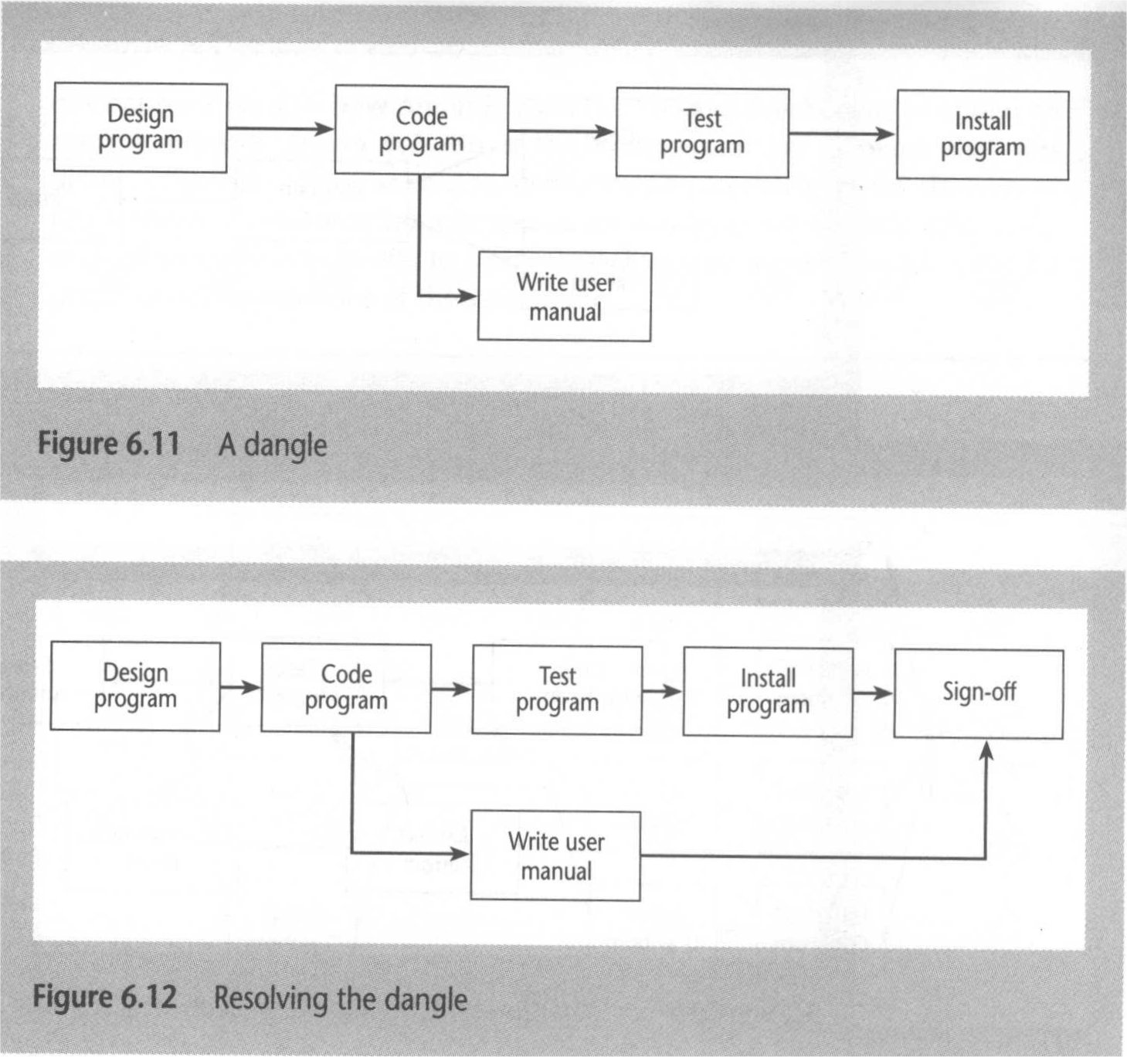
Dangles Are NOT Allowed in Precedence Network

Slide 19
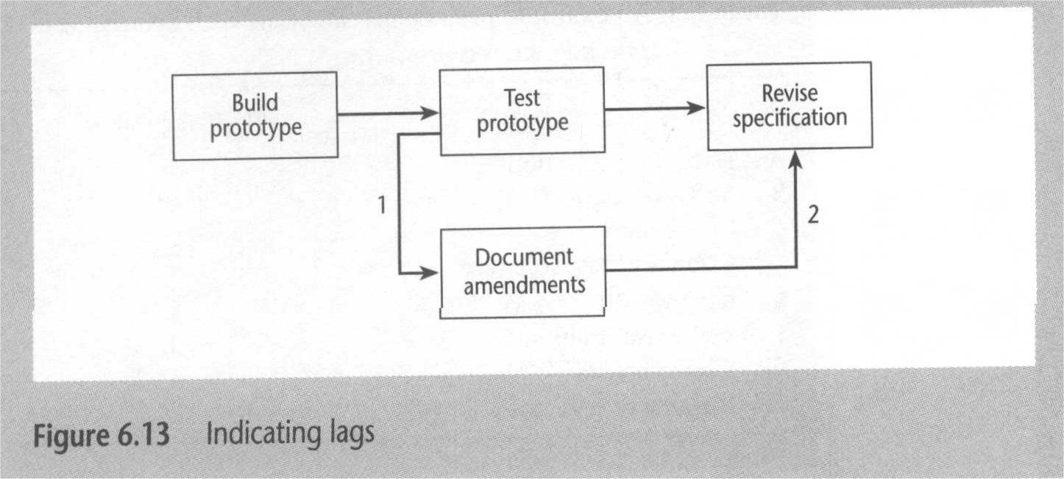
Representing Lagged Activities

Slide 20
Activity : Labeling Convention
Earliest Start (ES) | Duration | Earliest Finish (EF)
Activity Label, Activity Description
Latest Start (LS) | Float |  | Latest Finish (LF)

Slide 21
Refining the Network Model
Adding the time dimension
The Forward Pass –Identify the Earliest Date an Activity Can Start
The Backward Pass –Identify the Latest Date an Activity Can Start Without Delaying The End Date Of The Project
Identifying the Critical Path (defines the duration of the project; any delay to any activity on this critical path will delay the completion of the project)
Activity Float :
Total Float (LF – ES – Duration) [ Note: Total float AKA Float ]
Free Float ( time by which an activity may be delayed without affecting any subsequent activity)
Interfering Float (Total Float – Free Float )
Shortening the Project Duration
Identifying Critical Activities
The critical path
The near-critical path
Dynamics and monitoring

Slide 22
Float
Float = Latest Finish - Earliest Start - Duration
FLOAT
LF
ES
activity
LS
EF

Slide 23
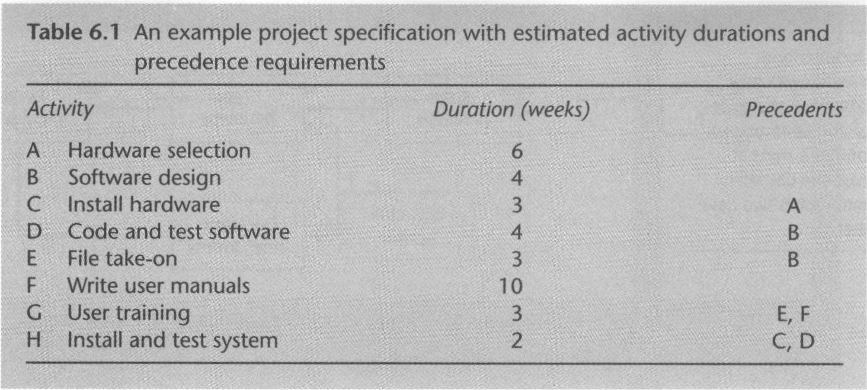
Project Activity: An Example

Slide 24
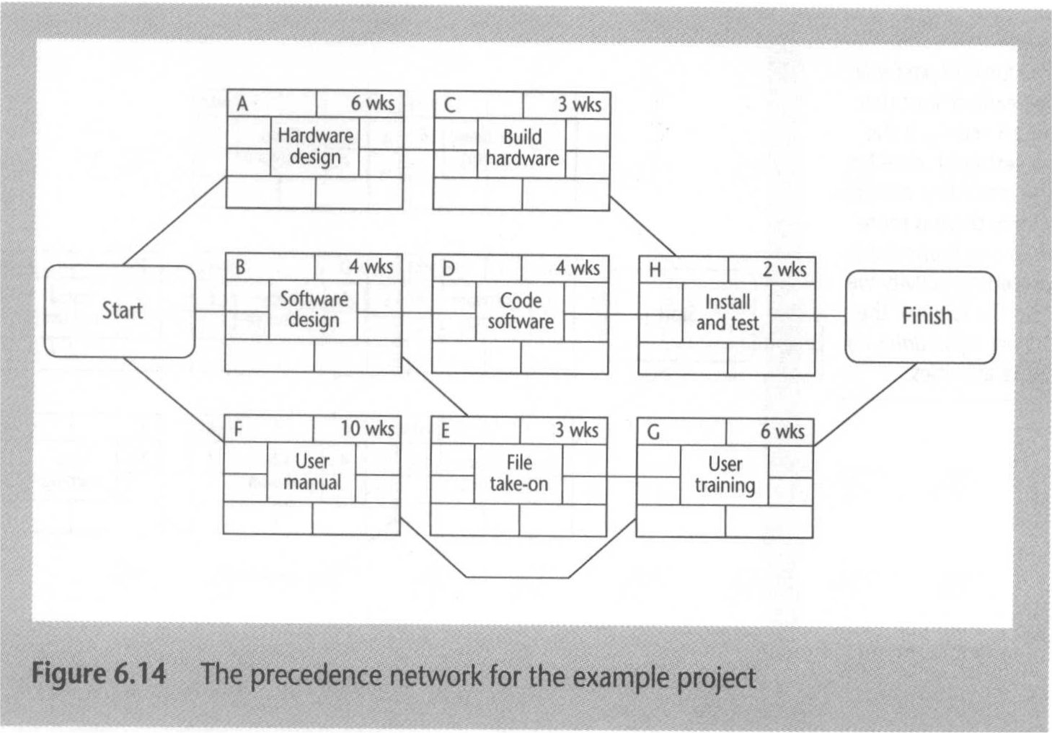
Example of Precedence Network

Slide 25
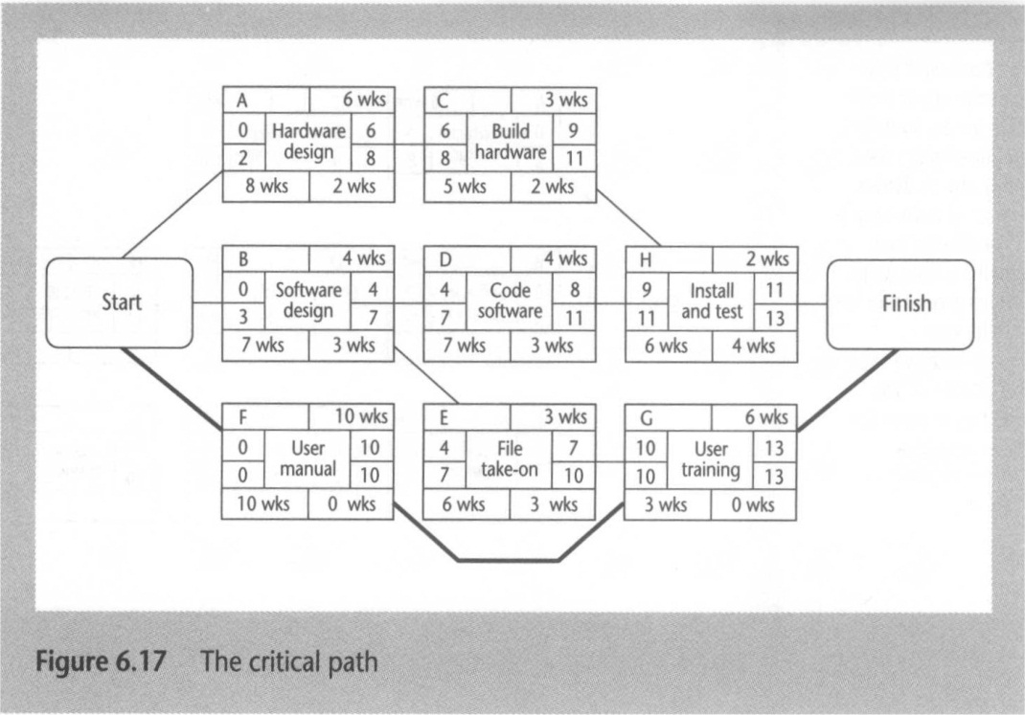
Example of Precedence Network

